Slide 1
Project 3
Gravitational Wave and Black Hole
Yaoqi Lei, Haechan Jung, Yuhang Mao

Slide 2
intoduction

Slide 3
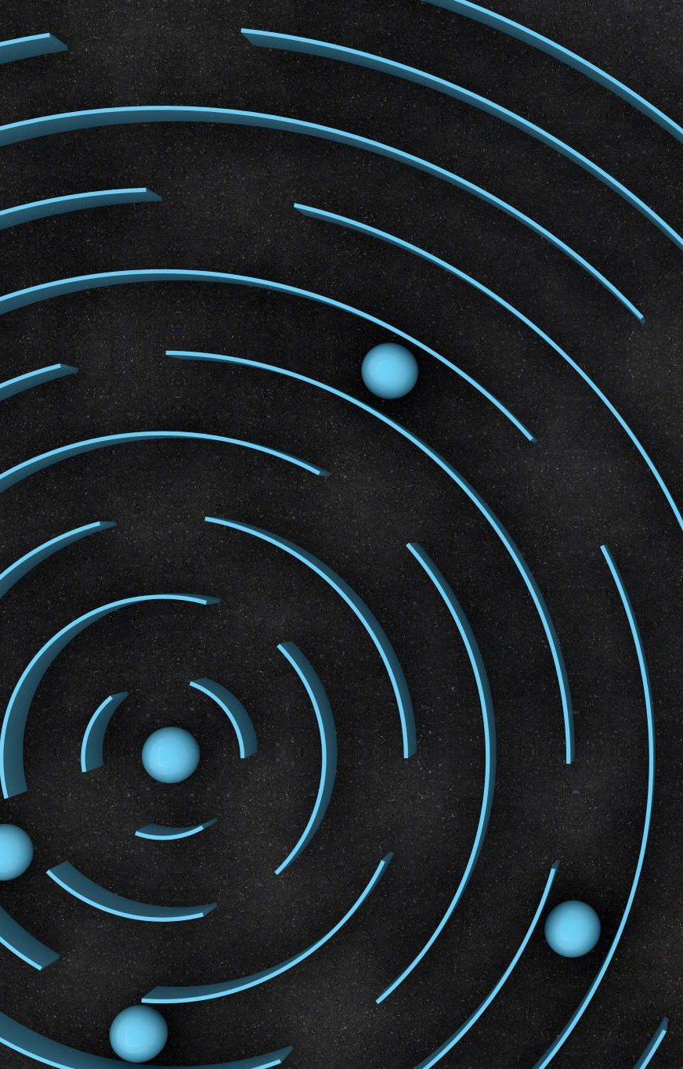
Gravitational Waves
Gravitational waves are transient displacement in a gravitational field – generated by the relative motion of gravitating masses – that radiate outward from their source at the speed of light.
Gravitational waves transport energy as gravitational radiation, a form of radiant energy similar to electromagnetic radiation.
In gravitational-wave astronomy, observations of gravitational waves are used to infer data about the sources of gravitational waves. Sources that can be studied this way include binary star systems composed of white dwarfs, neutron stars, and black holes; events such as supernovae; and the formation of the early universe shortly after the Big Bang.
Einstein’s view: Space can have moving ‘ripples’, called gravitational waves.

Slide 4
Black Hole
A black hole is a region of spacetime wherein gravity is so strong that no matter or electromagnetic energy (e.g. light) can escape it.
Anyway, this is a very massive object. That means its motion produces gravitational waves that are easier to observe.

Slide 5
target

Slide 6
use gravitational waves to observe a black hole merger.

Slide 7
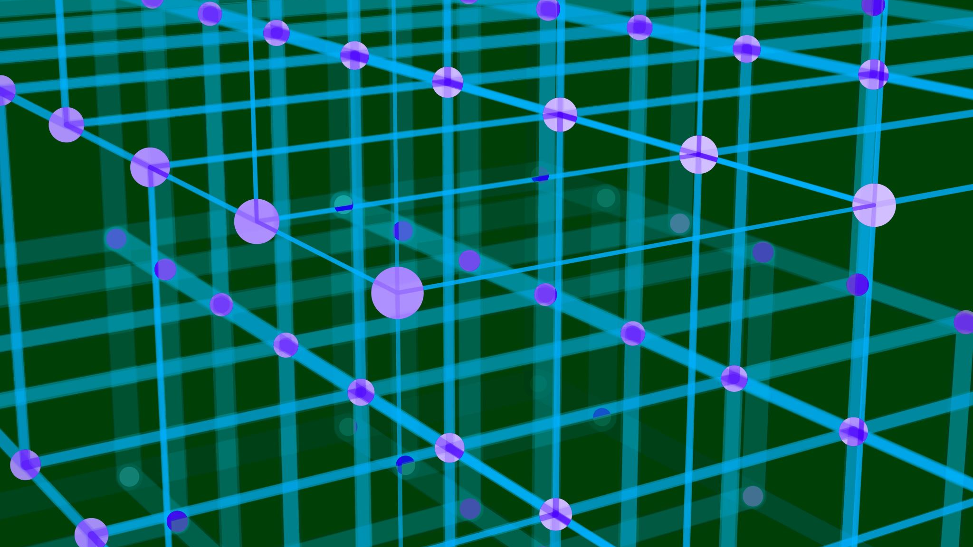
method

Slide 8
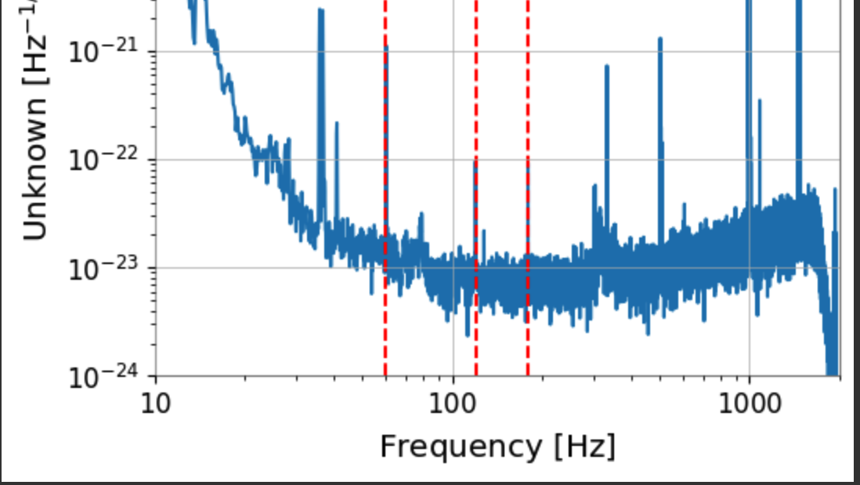
Step 1
First, we intercept a packet of gravitational wave events from the gwpy database.

Slide 9
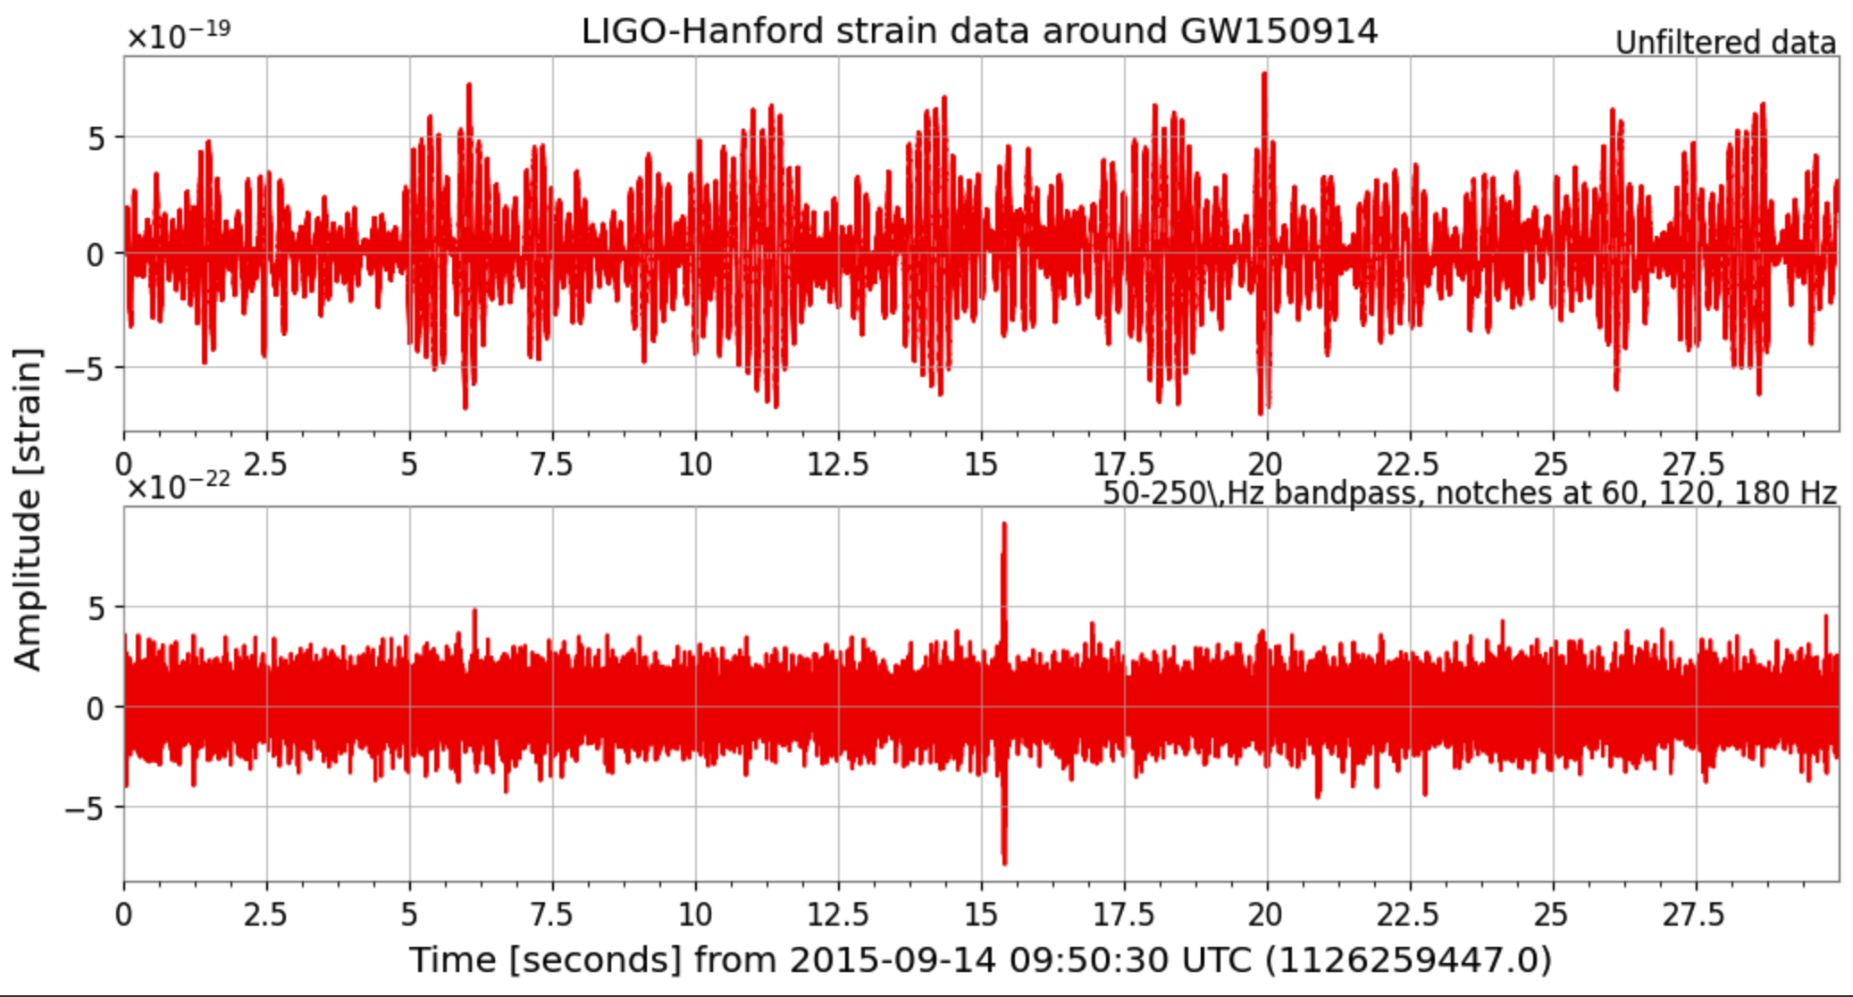
STEP 2
De-noise the raw data.

Slide 10
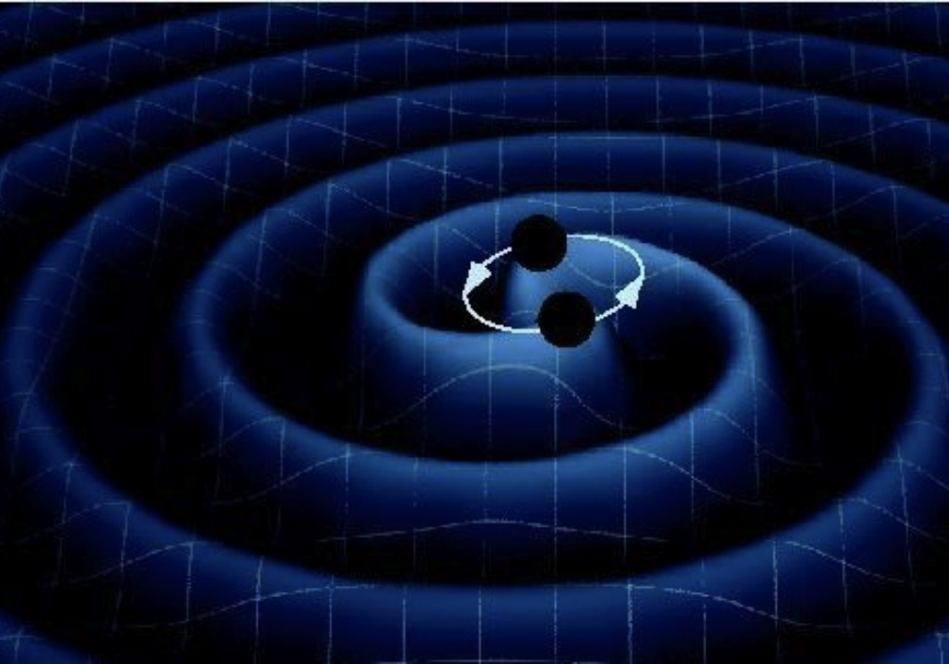
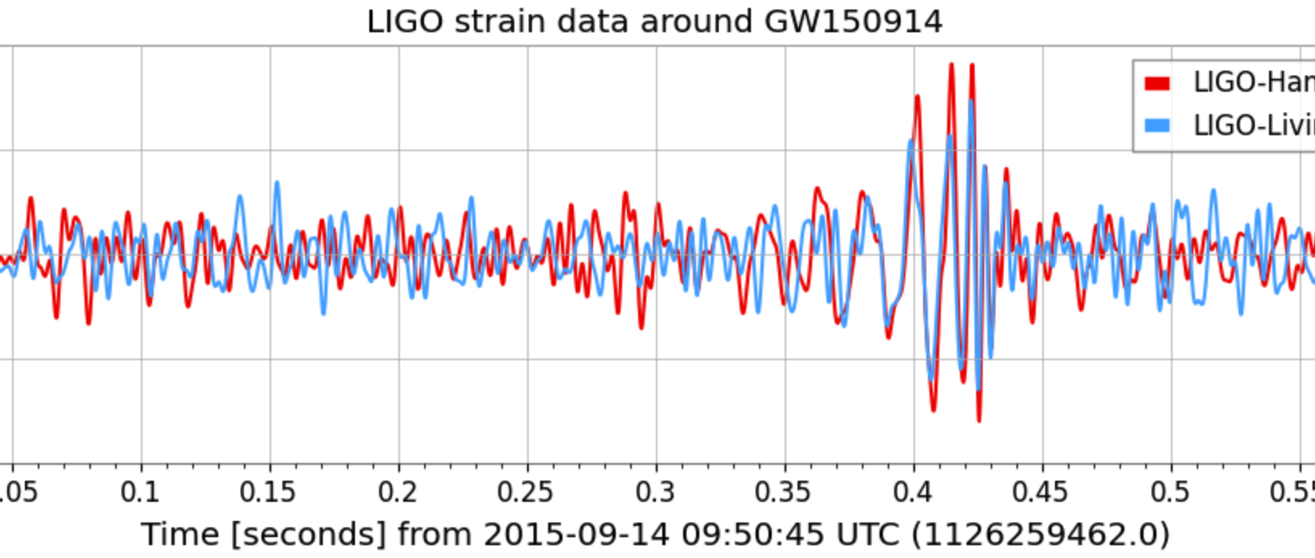
STEP 3
We enlarged the peak portion and overlapped the LIGO-Hanford and LIGO-Livingston data.
We can see that as the two black holes move closer together, the gravitational waves get stronger and stronger. But when they merged, the gravitational waves suddenly fell back to normal levels.

Slide 11
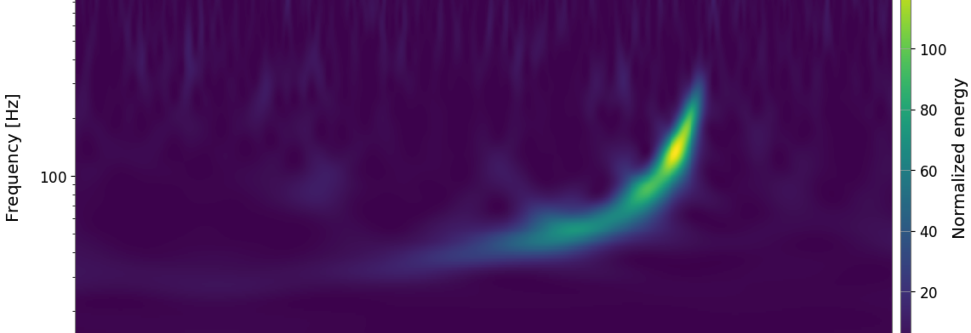
Step 4
Draw a time-frequency graph and use colors to indicate normalized energy.

Slide 12
Thanks For Listen.

